Slide 1
Media Access Control (MAC)
The data link layer (Layer 2) of the OSI model actually consists of two sublayers: the Media Access Control (MAC) sublayer and the Logical Link Control (LLC) sublayer.
The MAC sublayer controls device interaction.
The LLC sublayer deals with addressing and multiplexing.
Many protocols have been devised to handle access to a shared link. All of these protocols belong to a sublayer in the data-link layer called media access control (MAC).
Media access control regulates how a network is accessed by computer terminals and transmits from one terminal to the other without collision. This is achieved through CSMA/CD, CSMA/CA, demand priority, or Token passing.
A Media Access Control (MAC) address, sometimes referred to as a hardware or physical address, is a unique, 12-character alphanumeric attribute that is used to identify individual electronic devices on a network.
An example of a MAC address is: 00-B0-D0-63-C2-26.

Slide 2
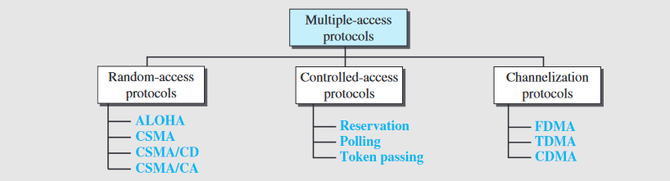
Taxonomy of Multiple Access Protocol

Slide 3
Random Access Protocols
When a sender and receiver have a dedicated link to transmit data packets, the data link control is enough to handle the channel.
Suppose there is no dedicated path to communicate or transfer the data between two devices.
In that case, multiple stations access the channel and simultaneously transmits the data over the channel. It may create collision and cross talk.
Hence, the multiple access protocol is required to reduce the collision and avoid crosstalk between the channels.

Slide 4
Random Access Protocols
In this protocol, all the station has the equal priority to send the data over a channel.
In random access protocol, one or more stations cannot depend on another station nor any station control another station.
Depending on the channel's state (idle or busy), each station transmits the data frame.
However, if more than one station sends the data over a channel, there may be a collision or data conflict. Due to the collision, the data frame packets may be lost or changed.
Hence, it does not receive by the receiver end.
Following are the different methods of random-access protocols for broadcasting frames on the channel.
Aloha
CSMA
CSMA/CD
CSMA/CA

Slide 5
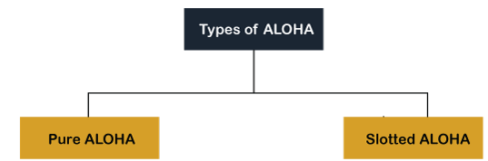
ALOHA
It is designed for wireless LAN (Local Area Network) but can also be used in a shared medium to transmit data.
Using this method, any station can transmit data across a network simultaneously when a data frameset is available for transmission.
Aloha Rules
Any station can transmit data to a channel at any time.
It does not require any carrier sensing.
Collision and data frames may be lost during the transmission of data through multiple stations.
Acknowledgment of the frames exists in Aloha. Hence, there is no collision detection.
It requires retransmission of data after some random amount of time.

Slide 6
Pure ALOHA
Whenever data is available for sending over a channel at stations, we use Pure Aloha.
In pure Aloha, when each station transmits data to a channel without checking whether the channel is idle or not, the chances of collision may occur, and the data frame can be lost.
When any station transmits the data frame to a channel, the pure Aloha waits for the receiver's acknowledgment.
If it does not acknowledge the receiver end within the specified time, the station waits for a random amount of time, called the backoff time (Tb).
The station may assume the frame has been lost or destroyed. Therefore, it retransmits the frame until all the data are successfully transmitted to the receiver.
The total vulnerable time of pure Aloha is 2 * Tfr.
Maximum throughput occurs when G = 1/ 2 that is 18.4%.
Successful transmission of data frame is S = G * e ^ - 2 G.

Slide 7
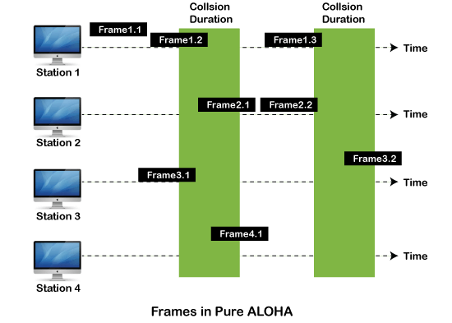
Frames in Pure ALOHA
There are four stations for accessing a shared channel and transmitting data frames.
Some frames collide because most stations send their frames at the same time. Only two frames, frame 1.1 and frame 2.2, are successfully transmitted to the receiver end.
At the same time, other frames are lost or destroyed. Whenever two frames fall on a shared channel simultaneously, collisions can occur, and both will suffer damage.
If the new frame's first bit enters the channel before finishing the last bit of the second frame.
Both frames are completely finished, and both stations must retransmit the data frame.

Slide 8
Slotted ALOHA
The slotted Aloha is designed to overcome the pure Aloha's efficiency because pure Aloha has a very high possibility of frame hitting.
In slotted Aloha, the shared channel is divided into a fixed time interval called slots. So that, if a station wants to send a frame to a shared channel, the frame can only be sent at the beginning of the slot, and only one frame is allowed to be sent to each slot.
If the stations are unable to send data to the beginning of the slot, the station will have to wait until the beginning of the slot for the next time.
However, the possibility of a collision remains when trying to send a frame at the beginning of two or more station time slot.
Maximum throughput occurs in the slotted Aloha when G = 1 that is 37%.
The probability of successfully transmitting the data frame in the slotted Aloha is S = G * e ^ - 2 G.
The total vulnerable time required in slotted Aloha is Tfr.

Slide 9
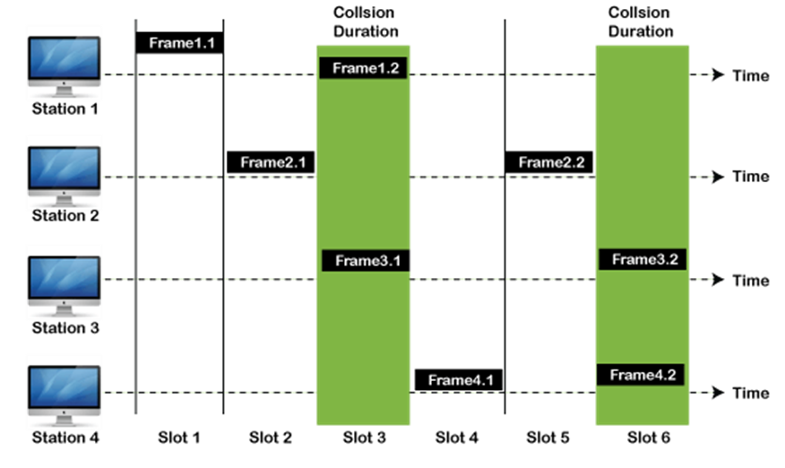
Frames in Slotted ALOHA

Slide 10
CSMA (Carrier Sense Multiple Access)
CSMA stands for Carrier Sense Multiple Access (CSMA). CSMA is one of the network protocols which works on the principle of ‘carrier sense’.
CSMA is a protocol developed to increase the performance of the network and reduce the chance of collision in the network.
If any device wants to send data then the device first senses or listens to the network medium to check whether the shared network is free or not. If the channel is found idle then the device will transmit its data.
This sense reduces the chance of collision in the network but this method is not able to eliminate the collision.
Carrier Sense Multiple Access (CSMA) is a protocol that senses or listens to the medium before any transmission of data in the medium.
CSMA is used in Ethernet networks where two or more network devices are connected.

Slide 11
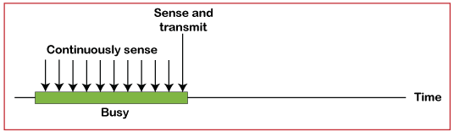
CSMA (Carrier Sense Multiple Access)
It is a carrier sense multiple access based on media access protocol to sense the traffic on a channel (idle or busy) before transmitting the data.
It means that if the channel is idle, the station can send data to the channel. Otherwise, it must wait until the channel becomes idle. Hence, it reduces the chances of a collision on a transmission medium.
CSMA Access Modes
1-Persistent: In the 1-Persistent mode of CSMA that defines each node, first sense the shared channel and if the channel is idle, it immediately sends the data.
Else it must wait and keep track of the status of the channel to be idle and broadcast the frame unconditionally as soon as the channel is idle.

Slide 12
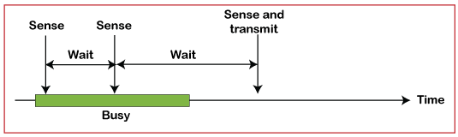
CSMA (Carrier Sense Multiple Access)
Non-Persistent: It is the access mode of CSMA that defines before transmitting the data, each node must sense the channel, and if the channel is inactive, it immediately sends the data.
Otherwise, the station must wait for a random time (not continuously), and when the channel is found to be idle, it transmits the frames.

Slide 13
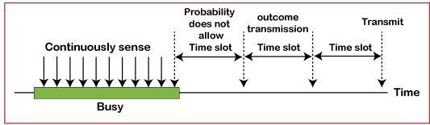
CSMA (Carrier Sense Multiple Access)
P-Persistent: It is the combination of 1-Persistent and Non-persistent modes. The P-Persistent mode defines that each node senses the channel, and if the channel is inactive, it sends a frame with a P probability.
If the data is not transmitted, it waits for a (q = 1-p probability) random time and resumes the frame with the next time slot.
O- Persistent: It is an O-persistent method that defines the superiority of the station before the transmission of the frame on the shared channel.
If it is found that the channel is inactive, each station waits for its turn to retransmit the data.

Slide 14
Pure ALOHA Numerical
Q1. A pure ALOHA network transmits 200-bit frames on a shared channel of 200 kbps. What is the requirement to make this frame collision-free?
Solution:
Average frame transmission time Tfr is 200 bits/200 kbps or 1 ms.
The vulnerable time is 2 × 1 ms =2 ms.
This means no station should send later than 1 ms before this station starts transmission and no station should start sending during the period (1 ms) that this station is sending.
Q2. A pure ALOHA network transmits 200-bit frames on a shared channel of 200 kbps. What is the throughput if the system (all stations together) produces 1000 frames per second?
Solution:
The frame transmission time is 200/200 kbps or 1 ms.
If the system creates 1000 frames per second, or 1 frame per millisecond, then G = 1.
In this case S = G × e−2G = 0.135 (13.5 percent).
This means that the throughput is 1000 × 0.135 = 135 frames. Only 135 frames out of 1000 will probably survive.

Slide 15
Slotted ALOHA Numericals
Q3. A slotted ALOHA network transmits 200-bit frames using a shared channel with a 200-kbps
bandwidth. Find the throughput if the system (all stations together) produces
a. 1000 frames per second.
b. 500 frames per second.
c. 250 frames per second.
Solution :
This situation is similar to the previous exercise except that the network is using slotted ALOHA instead of pure ALOHA.
The frame transmission time is 200/200 kbps or 1 ms.
a. In this case G is 1. So S = G × e−G = 0.368 (36.8 percent).
This means that the throughput is 1000 × 0.0368 = 368 frames. Only 368 out of 1000 frames will probably survive. Note that this is the maximum throughput case, percentagewise.
b. Here G is 1/2. In this case S = G × e−G = 0.303 (30.3 percent). This means that the throughput is 500 × 0.0303 = 151. Only 151 frames out of 500 will probably survive.
c. Now G is 1/4. In this case S = G × e−G = 0.195 (19.5 percent). This means that the throughput is 250 × 0.195 = 49. Only 49 frames out of 250 will probably survive.

Slide 16
CSMA / CD(Carrier Sense Multiple Access / Collision Detection)
Carrier sense multiple access / collision detection is one of the network protocols for transmission. CSMA/CD protocol works with the medium access control layer of the network.
That’s why the station senses the channel before transmission of data and if the station finds the channel idle then the station transmits its data frames to check whether data transmission is successful in the network or not.
If the station successfully the data frame sent then it will again send the next frame. If the station detects a collision in the network, then in CSMA/CD the station will send the stop/jam signal to all the stations connected in the network to terminate their transmission of data.
Then the station waits for a random amount of time for the transmission of data.

Slide 17
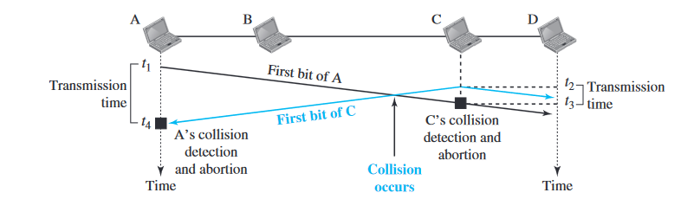
CSMA / CD(Carrier Sense Multiple Access / Collision Detection)
At time t1, station A has executed its persistence procedure and starts sending the bits of its frame. At time t2 , station C has not yet sensed the first bit sent by A.
Station C executes its persistence procedure and starts sending the bits in its frame, which propagate both to the left and to the right. The collision occurs some time after time t2 .
Station C detects a collision at time t3 when it receives the first bit of A’s frame. Station C immediately (or after a short time, but we assume immediately) aborts transmission.
Station A detects collision at time t4 when it receives the first bit of C’s frame; it also immediately aborts transmission. Looking at the figure, we see that A transmits for the duration t4 − t1 ; C transmits for the duration t3 − t2 .

Slide 18
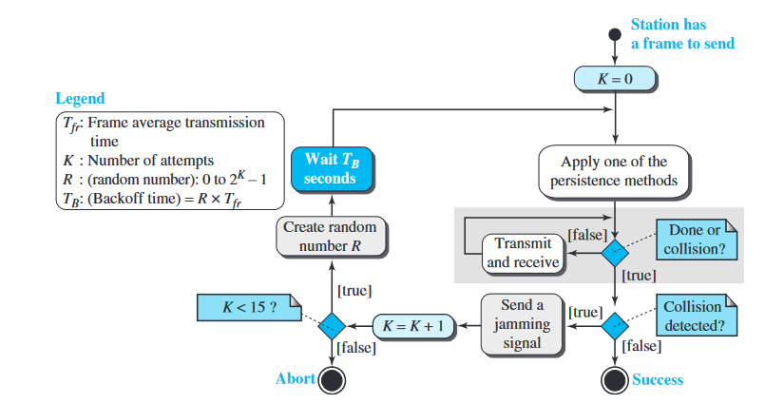
Flow diagram of CSMA / CD

Slide 19
CSMA / CD(Carrier Sense Multiple Access / Collision Detection)
Q4. A network using CSMA/CD has a bandwidth of 10 Mbps. If the maximum propagation time (including the delays in the devices and ignoring the time needed to send a jamming signal, is 25.6 μs, what is the minimum size of the frame?
Solution:
The minimum frame transmission time is Tfr = 2 × Tp = 51.2 μs.
This means, in the worst case, a station needs to transmit for a period of 51.2 μs to detect the collision.
The minimum size of the frame is 10 Mbps × 51.2 μs = 512 bits or 64 bytes.

Slide 20
CSMA / CA (Carrier Sense Multiple Access / Collision Avoidance)
Carrier sense multiple access/collision avoidance is one of the network protocols for data frame transmission.
When the station sends the data frame on the channel it receives the acknowledgment in response to the sent data frame to test whether the channel is idle or not.
When the station receives a single signal i.e. its signal this means that there is no collision and data has been successfully received by the receiver.
But in case of collision, the station receives two signals: its signal and the second signal sent by the other station.
In CSMA/CA collision is avoided by using the following three strategies:
Interframe space
Contention window
Acknowledgement

Slide 21
CSMA / CA (Carrier Sense Multiple Access / Collision Avoidance)
Interframe Space or IFS: If the station wants to transmit the data then it waits until the channel becomes idle and when the channel becomes idle station does not immediately send the data but waits for some time.
This period is known as the Interframe Space or IFS. IFS can also define the priority of the frame or station.
Contention window: The contention window is a time that is divided into time slots. When the station is ready for data transmission after waiting for IFS then it chooses the random amount of slots for waiting.
After waiting for the random number of slots if the channel is still busy then the station does not initiate the whole process again, the station stops its timer and restarts again when the channel is sensed idle.
Acknowledgement: There may be a chance of collision or data may be corrupted during the transmission. Positive acknowledgment and time-out are used in addition to ensuring that the receiver has successfully received the data.

Slide 22
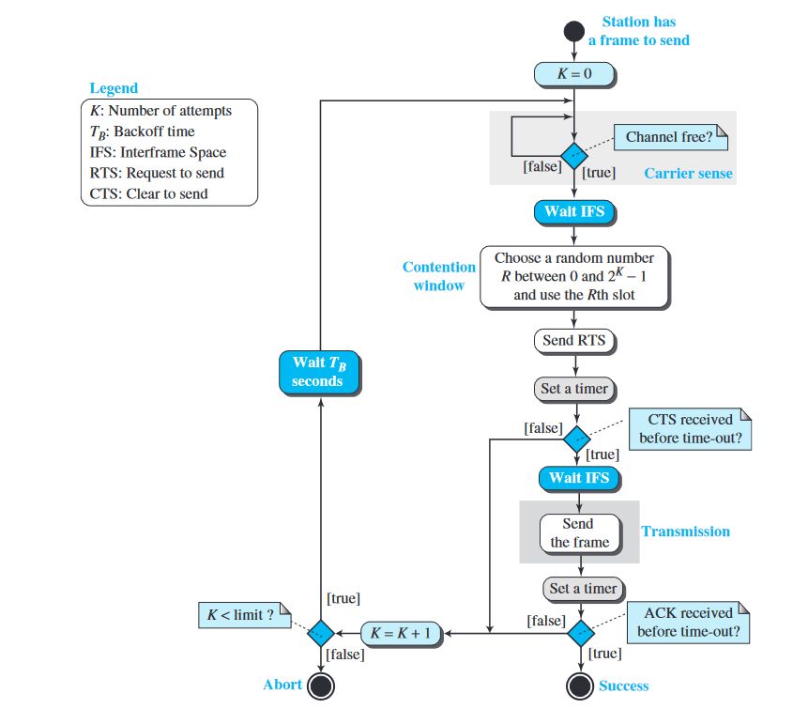
Flow diagram of CSMA / CA

Slide 23
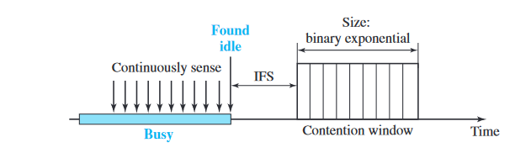
Timing in CSMA / CA

Slide 24
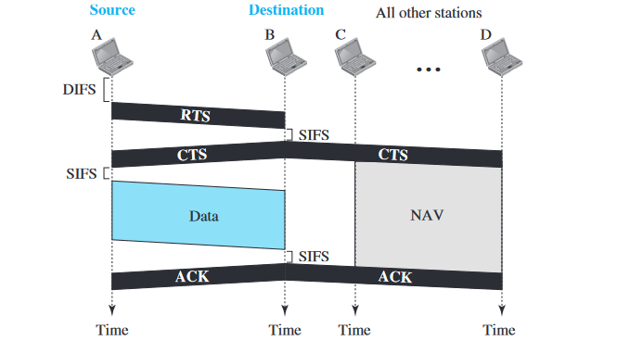
Frame Exchange Time Line

Slide 25
Frame Exchange Time Line
Before sending a frame, the source station senses the medium by checking the energy level at the carrier frequency.
The channel uses a persistence strategy with backoff until the channel is idle.
After the station is found to be idle, the station waits for a period of time called the DCF interframe space (DIFS); then the station sends a control frame called the request to send (RTS).
2. After receiving the RTS and waiting a period of time called the short interframe space (SIFS), the destination station sends a control frame, called the clear to send (CTS), to the source station.
This control frame indicates that the destination station is ready to receive data.
3. The source station sends data after waiting an amount of time equal to SIFS.
4. The destination station, after waiting an amount of time equal to SIFS, sends an acknowledgment to show that the frame has been received.
Acknowledgment is needed in this protocol because the station does not have any means to check for the successful arrival of its data at the destination. On the other hand, the lack of collision in CSMA/CD is a kind of indication to the source that data have arrived.

Slide 26
CSMA/CD Vs CSMA/CA
S.NO | CSMA/CD | CSMA/CA
1. | CSMA / CD is effective after a collision. | Whereas CSMA / CA is effective before a collision.
2. | CSMA / CD is used in wired networks. | Whereas CSMA / CA is commonly used in wireless networks.
3. | It only reduces the recovery time. | Whereas CSMA/ CA minimizes the possibility of collision.
4. | CSMA / CD resends the data frame whenever a conflict occurs. | Whereas CSMA / CA will first transmit the intent to send for data transmission.
5. | CSMA / CD is used in 802.3 standard. | While CSMA / CA is used in 802.11 standard.
6. | It is more efficient than simple CSMA(Carrier Sense Multiple Access). | While it is similar to simple CSMA(Carrier Sense Multiple Access).
7 | It is the type of CSMA to detect the collision on a shared channel. | It is the type of CSMA to avoid collision on a shared channel.
8. | It is work in MAC layer. | It is also work in MAC layer.

Slide 27
CSMA / CD and CSMA/ CA
Q5. Consider a CSMA/CD network that transmits data at a rate of 100 Mbps (10⁸ bits per second) over a 1 km (kilometre) cable with no repeaters. If the minimum frame size required for this network is 1250 bytes, what is the signal speed (km/sec) in the cable?
(A) 8000
(B)10000
(C)16000
(D) 20000
Q6. A network with CSMA/CD protocol in the MAC layer is running at 1 Gbps over a 1 km cable with no repeaters. The signal speed in the cable is 2 x 10⁸ m/sec. The minimum frame size for this network should be
(A)10000 bits (B) 10000 bytes (C) 5000 bits (D) 5000 bytes
Data should be transmitted at the rate of 100 Mbps.
Transmission Time >= 2*Propagation Time => 1250*8 / (100 * 10⁶) <=2*length/signal_speed => signal_speed <= (2 * 10³ * 100 * 10⁶) / (1250 * 8) <= 2 * 10 * (10³) km/sec <= 20000
Frame Size S >= 2BL/P Where, Cable Length L = 1KM = 1000M Propagation Speed P = 2 x 10^8 m/sec Bandwidth = 1 Gbps = 10^9 bps. S >= (2 * 10^9 * 1000) / (2 x 10^8) >= 10000 bits

Slide 28
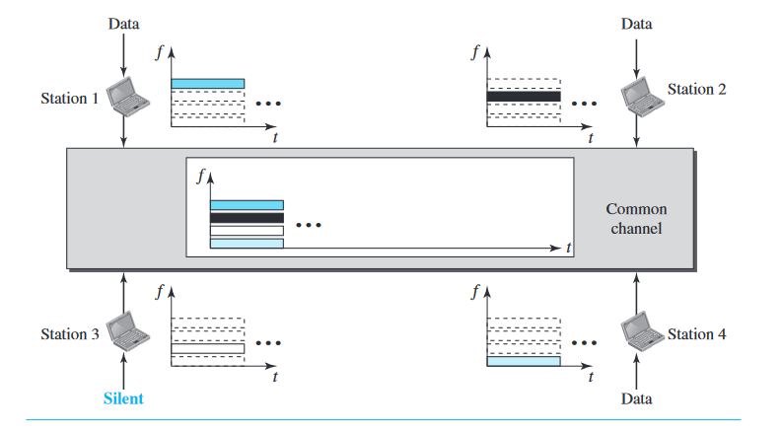
Frequency Division Multiple Access
In frequency-division multiple access (FDMA), the available bandwidth is divide into frequency bands. Each station is allocated a band to send its data.
In other words, each band is reserved for a specific station, and it belongs to the station all the time.
Each station also uses a bandpass filter to confine the transmitter frequencies.

Slide 29
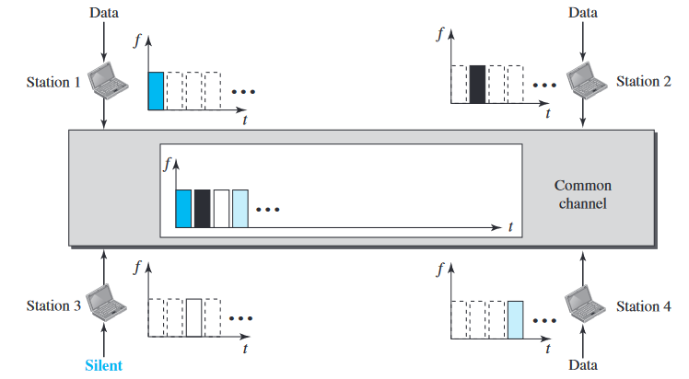
Time Division Multiple Access
In time-division multiple access (TDMA), the stations share the bandwidth of the channel in time.
Each station is allocated a time slot during which it can send data.
Each station transmits its data in its assigned time slot.

Slide 30
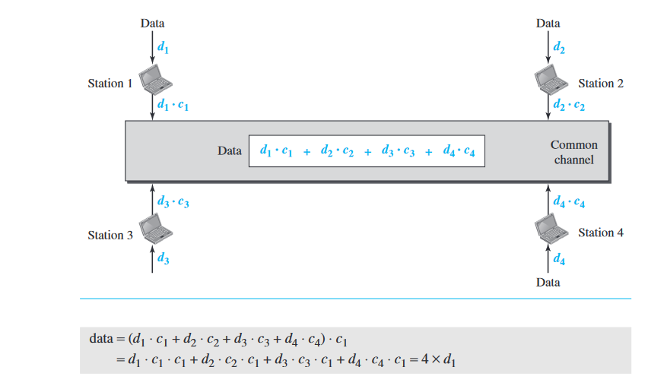
Code Division Multiple Access
CDMA differs from FDMA in that only one channel occupies the entire bandwidth of the link.
It differs from TDMA in that all stations can send data simultaneously;
There is no timesharing.

